Slide 1
INTRODUCTION TO CLASS BIVALVIA
DR AATHIRA V NAIR

Slide 2
The Class Bivalvia (bi = two, valvia = shells or valves), (formerly known as the Class Pelecypoda), is one of the largest classes in the Phylum Mollusca.
SYNONYMS:
Lamellibranchia , Pelecypoda
It includes clams, oysters, cockles, mussels, scallops; other families belong to salt water and fresh water.

Slide 3
CLAMS

Slide 4
OYSTER

Slide 5
COCKLES

Slide 6
MUSSELS

Slide 7
SCALLOPS

Slide 8
ADAPTATION:
- All bivalves are aquatic.
- Most are particularly adapted for living in mud and sand bottoms.
- Some are modified for boring into rocks and wood, other are firmly attached to fixed substrata.

Slide 9
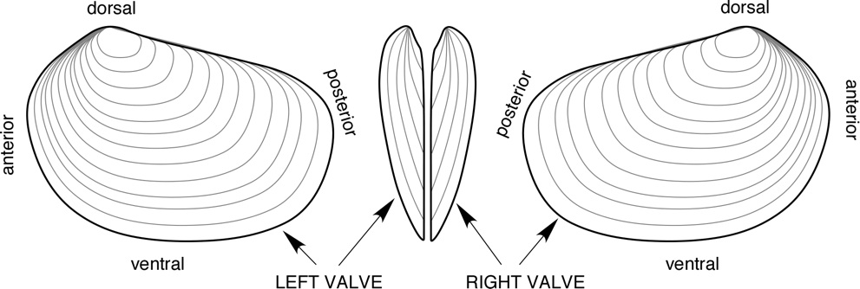
DESCRIPTION:
- Shell → CaCO3, consist of 2 parts called valves(bivalve)
- Shell → strong, solid or brittle, or weak and fragile
- Shell → anterior part → foot; posterior part→ siphons

Slide 10
Valve → joined together along one edge by a flexible ligament;
(HINGE ACTION) →for opening and closing of the shell without detaching the valves.

Slide 11
The soft body is enclosed within two hard calcareous, saucer-like valves.
They have no head.

Slide 12
The body of bivalves is laterally compressed (flattened sideways) and consists of 2 hinged valves that are mirror images of one another

Slide 13
In bivalves, the mantle (contains gills) forms a thin membrane that lines the inside surface of the shell.
This creates a mantle cavity (where gas exchange takes place), within which the entire body of the bivalve lies.
Strong muscles, the adductor muscles, are used to close the valves
Filter feeders; mostly they eat protozoans, algae, diatom,eggs, larvae and spores of algae.Few are scavengers and few carnivores.

Slide 14
THREAT :
Starfish, crab, Whelk, Birds
How Bivalves Attack:
capture prey in the sudden in rush of water into the mantle cavity.
Defence mechanism:
- Retreat
- Detached

Slide 15
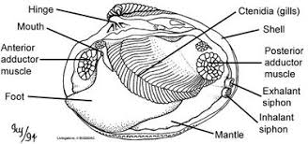
Two siphons, an incurrent and an excurrent siphon, draw water into and out of the mantle cavity, respectively
Since many clams burrow into the sediment, these siphons allow the clam to feed and breathe

Slide 16
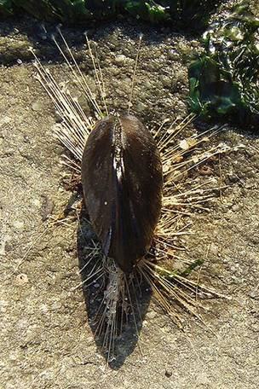
Not all bivalves are burrowers; mussels secrete strong byssal threads to attach to rocks and other surfaces

Slide 17
Oysters cement themselves to hard substances including other oysters
Scallops are unattached and can swim for short distances by rapidly ejecting water from the mantle cavity and flapping their valves

Slide 18
CHARACTERISTICS:
- To feed they use siphons.
- One siphon will carry water to the internal cavity and is known as the inhalant siphon, the other takes water away from the internal cavity and is known as the exhalant siphon.
- In certain cases these siphons can become fused, but the water in the two tubes still remains separate.

Slide 19
- The stomach is connected to the mouth by a short esophagus.
- Unlike other mollusks there is no radula(tongue like feeding structure)
- Rarely hermaphroditic. Fertilization occurs in the open water or in the mantle cavity.

Slide 20
REMEDIES INCLUDES
1. CONCHIOLINUM
2. CRASOSTREA GIGAS
3. MYTILUS EDULIS
4. PEARL
5. PEARL IMMERSION
6. PECTEN JACOBAEUS
7. PERNA CANALICULATA
8. VENUS MERCENARIA

Slide 21
DIGESTIVE SYSTEM
Modes of feeding
Use their gills to capture particulate food from the water.
These primitive bivalves hold on to the substratum with a pair of tentacles at the edge of the mouth.
The tentacles are covered in mucus, which traps the food, and cilia, which transport the particles. These then sort the particles, rejecting those that are unsuitable or too large to digest, and conveying others to the mouth.

Slide 22
EXCRETORY SYSTEM
The excretory organs of bivalves are a pair of nephridia.
Each of these consists of a long, looped, glandular tube, which opens into the body cavity just beneath the heart, and a bladder to store urine.
Metabolic waste is voided from the bladders through a pair of openings near the front of the upper part of the mantle cavity, from where it joins the stream of exhalant water.

Slide 23
NEPHRIDIA

Slide 24
REPRODUCTIVE SYSTEM
→The sexes are usually separate in bivalves but some hermaphroditism is known.
The gonads are located close to the intestines, and either open into the nephridia, or through a separate pore into the mantle cavity.
The ripe gonads of male and females release sperm and eggs into the water column.
Spawning (the process of releasing the eggs and sperm, and the act of both sexes is called spawning) may take place continually or be triggered by environmental factors such as day length, water temperature, or the presence of sperm in the water.

Slide 26
POLYPLACOPHORA

Slide 27
The Class Polyplacophora (poly = many, placo = tablet, phoros = bearing)
SYNONYMS:sea cradles or "coat-of-mail shells", or more formally as loricates, polyplacophorans

Slide 28
ADAPTATION:
These animals, commonly called chitons, have a worldwide distribution in the intertidal zone or in relatively shallow water where sunlight is present and where plants grow.
Some chitons live in depths to 6,000 meters and some hunt meat.
Chitons are the familiar group of organisms that have eight valves on their shells.

Slide 30
DESCRIPTION:
Chitons are flattened, elongately-oval, with eight overlapping dorsal shell plates or valves
bordered by a thick girdle formed from the mantle that may be covered with spines, scales, or hairs.
The shell valves are composed of four layers: the outer periostracum, which contains most of the pigments; the tegmentum, which is perforated by numerous horizontal and vertical canals; the articulamentum and innermost the hypostracum, a thin layer found only in some regions of the valves.

Slide 31
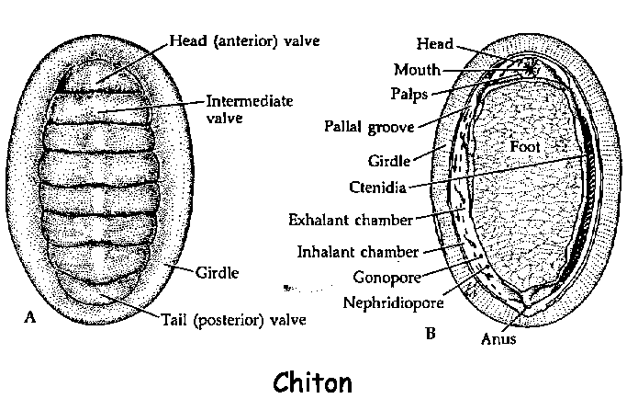
The pallial cavity, containing multiple pairs of small gills, surrounds the foot with which the animal typically clings to hard surfaces.
The plates are greatly reduced or even internal in a few species, these species sometimes having an elongate, somewhat worm-like body. Most are small (0.5-5 cm, but one species reaches over 30 cm in length).

Slide 32
CHARACTERISTICS:
strictly marine animals are herbivores or plant eaters.
The head is small, anteriorly situated, and hidden from dorsal view by the girdle
Chitons, like most members of the Phylum Mollusca, have a file-like tongue called a radula.
A chiton has a single large foot for locomotion.
Along the edge of the foot and suspended in the mantle cavity are the gills for respiration.
On the outside edge of the mantle cavity is the fleshy girdle that is often covered in bristles or other structures

Slide 33
The three-chambered heart is located towards the animal's hind end.
Each of the two auricles collects blood from the gills on one side, while the muscular ventricle pumps blood through the aorta and round the body.

Slide 34
Digestive System of Chiton:
The mouth is a round or oval aperture, situated at the centre of the head. The mouth leads into a very short buccal tube which is lined by epithelium thrown into longitudi­nal folds
The buccal cavity bears a pair of simple buccal glands.
This organ is regarded as chemoreceptor and can be pro­truded into the mouth to test the substratum for food.

Slide 35
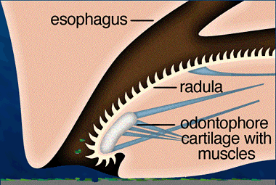
There are no jaws in Chiton.
The buccal cavity contains a long ribbon-like radula. The radula is enclosed by connective tissue sheath and contains transverse rows of teeth.

Slide 36
Sense Organs of Chiton:
Specialised sense organs are lacking in Chiton
Reproductive System of Chiton:
The sexes are separate.
The testis and ovary are more or less similar in appearance.

Slide 37
THANK YOU…….

